Slide 1
enlight
An optimized raycasting approach for subtractive manufacturing simulation and visualization

Slide 2
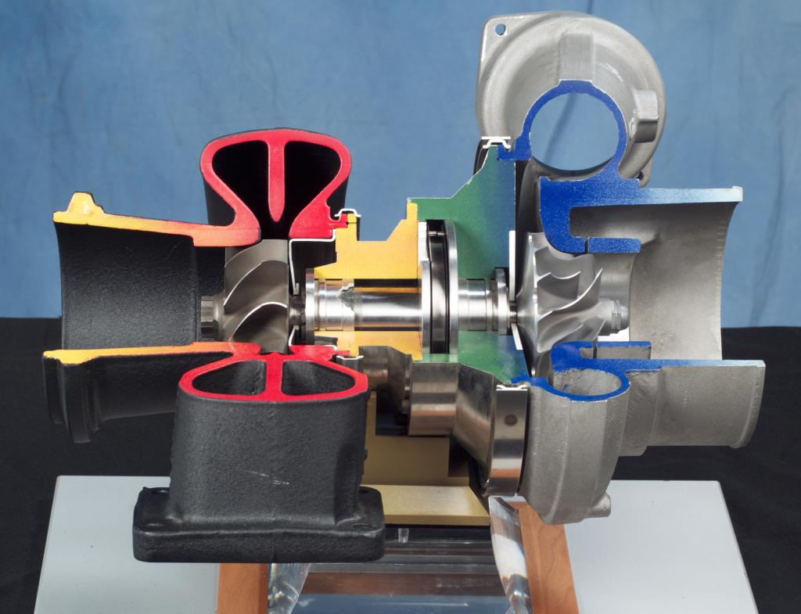
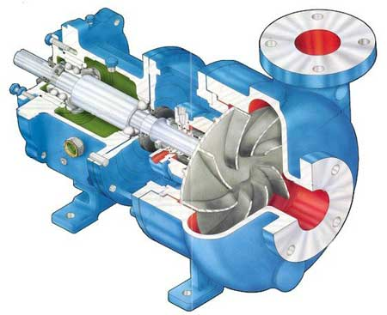
Industrial components e.g. impellers
http://en.wikipedia.org/wiki/File:Turbocharger.jpg
http://www.globalpumps.in/matherplatt.html

Slide 3
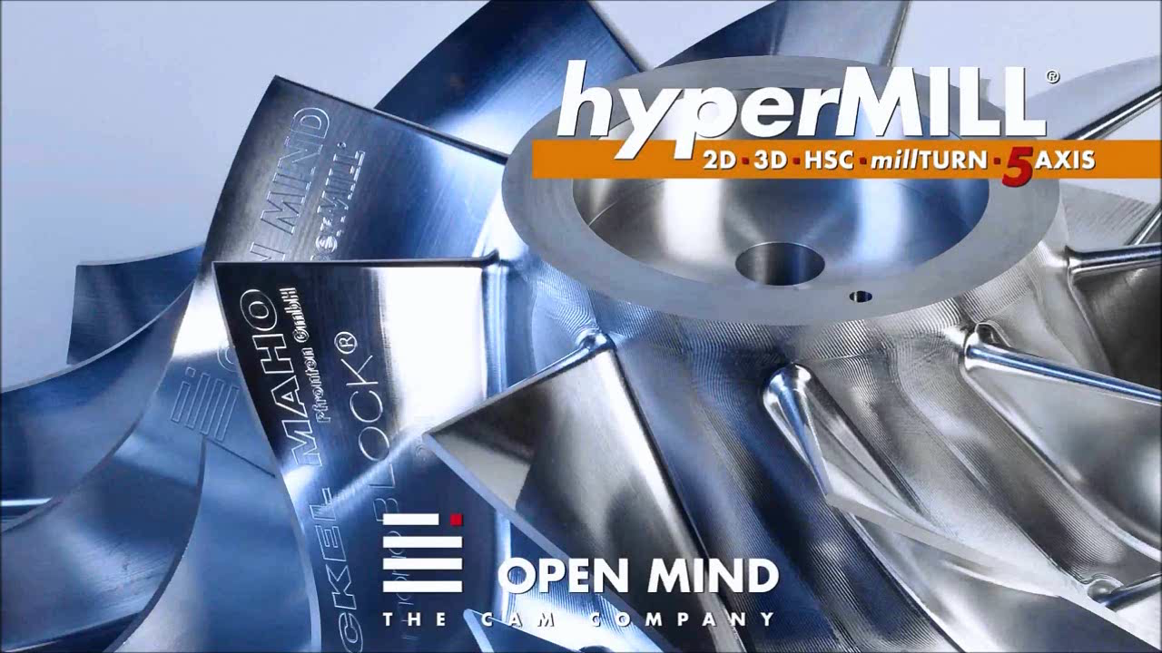
Milling - Subtractive manufacturing
Adapted from: https://www.youtube.com/watch?v=P0ImcDi_B0o

Slide 4
Overview
Problem

Slide 5
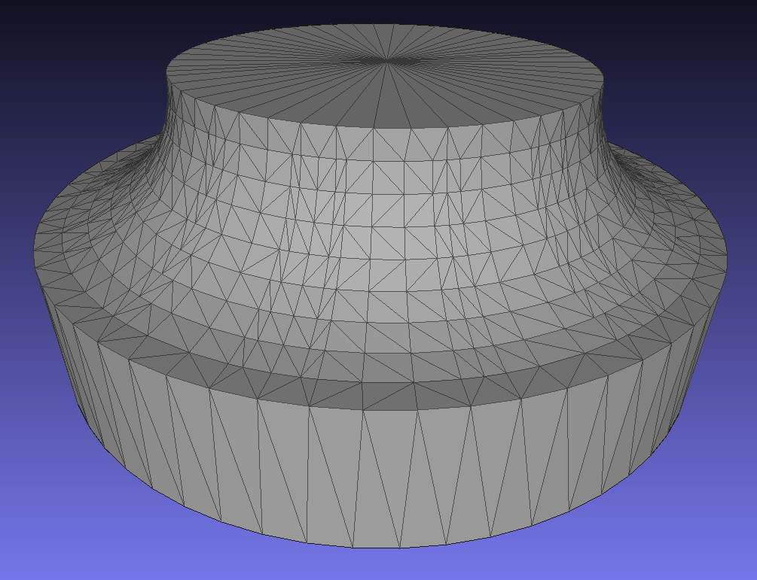
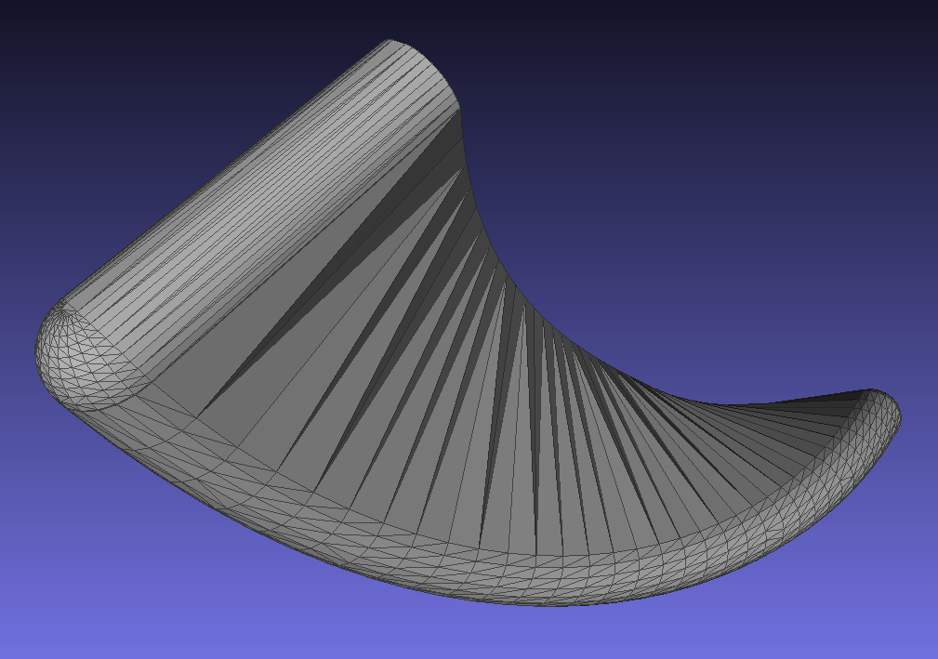
Input for digital simulation
MeshLab screen shots of low resolution input meshes

Slide 6
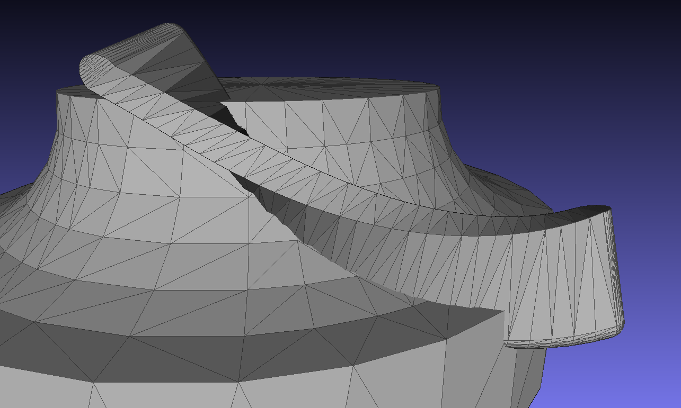
Problem

Slide 7
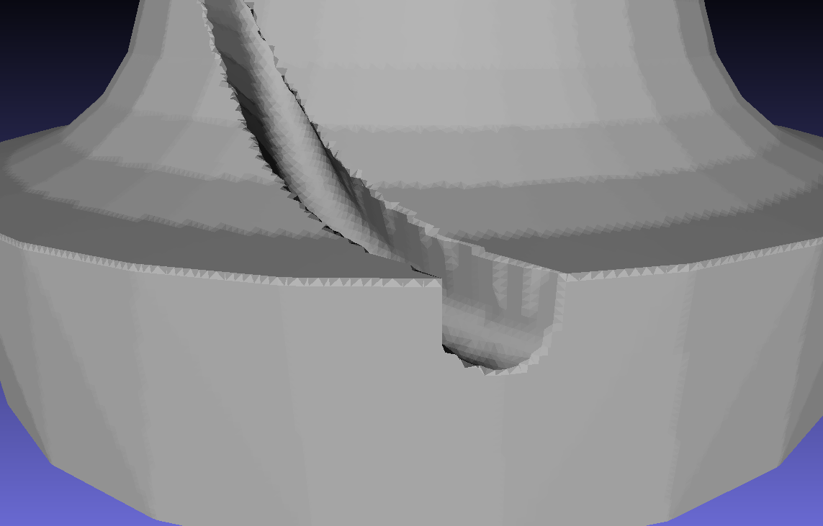
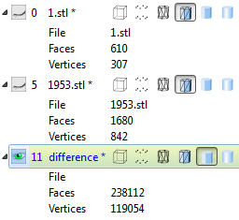
Existing methods – e.g. marching cubes
Explicit surface calculation using MeshLab

Slide 8
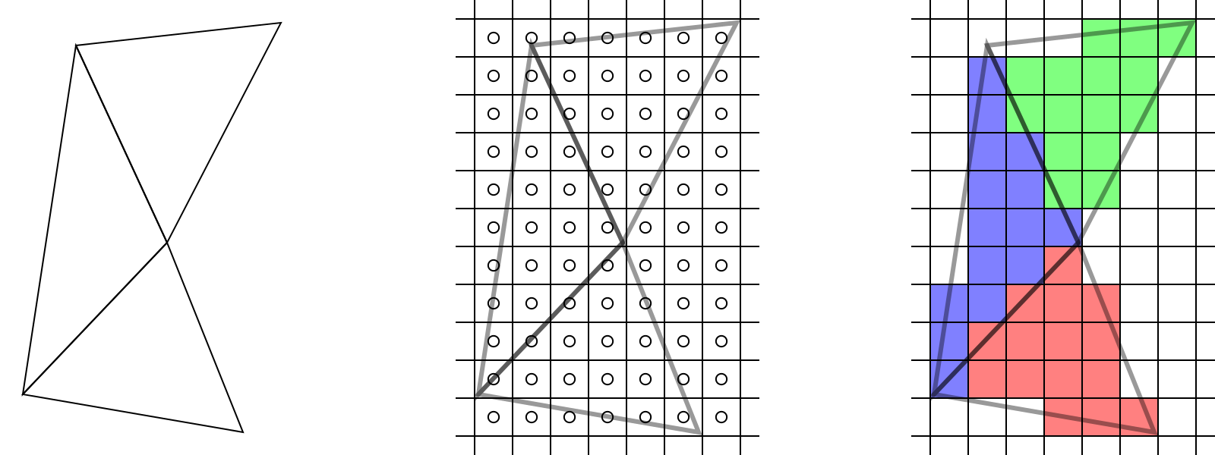
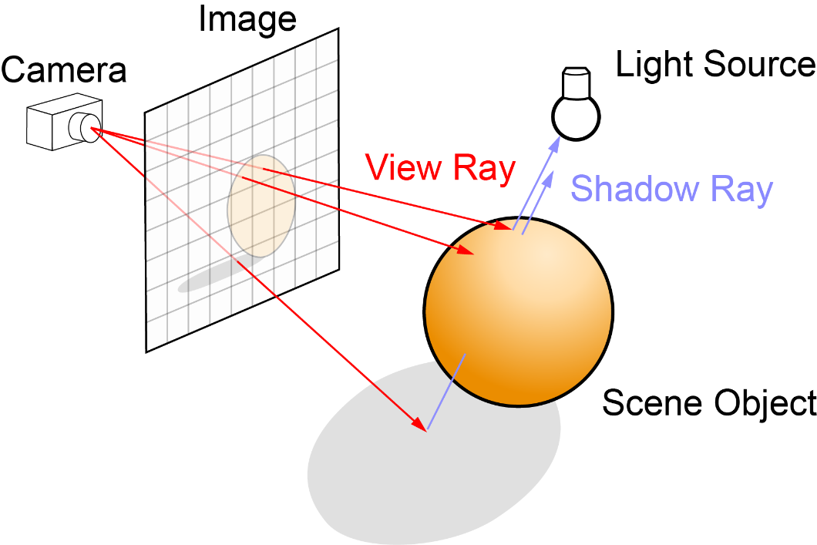
Rendering 3D geometry
Rasterization (OpenGL, DirectX)
Ray tracing/casting
http://www.arcsynthesis.org/gltut/basics/Intro%20Graphics%20and%20Rendering.html
http://en.wikipedia.org/wiki/Ray_tracing_(graphics)#mediaviewer/File:Ray_trace_diagram.svg

Slide 9
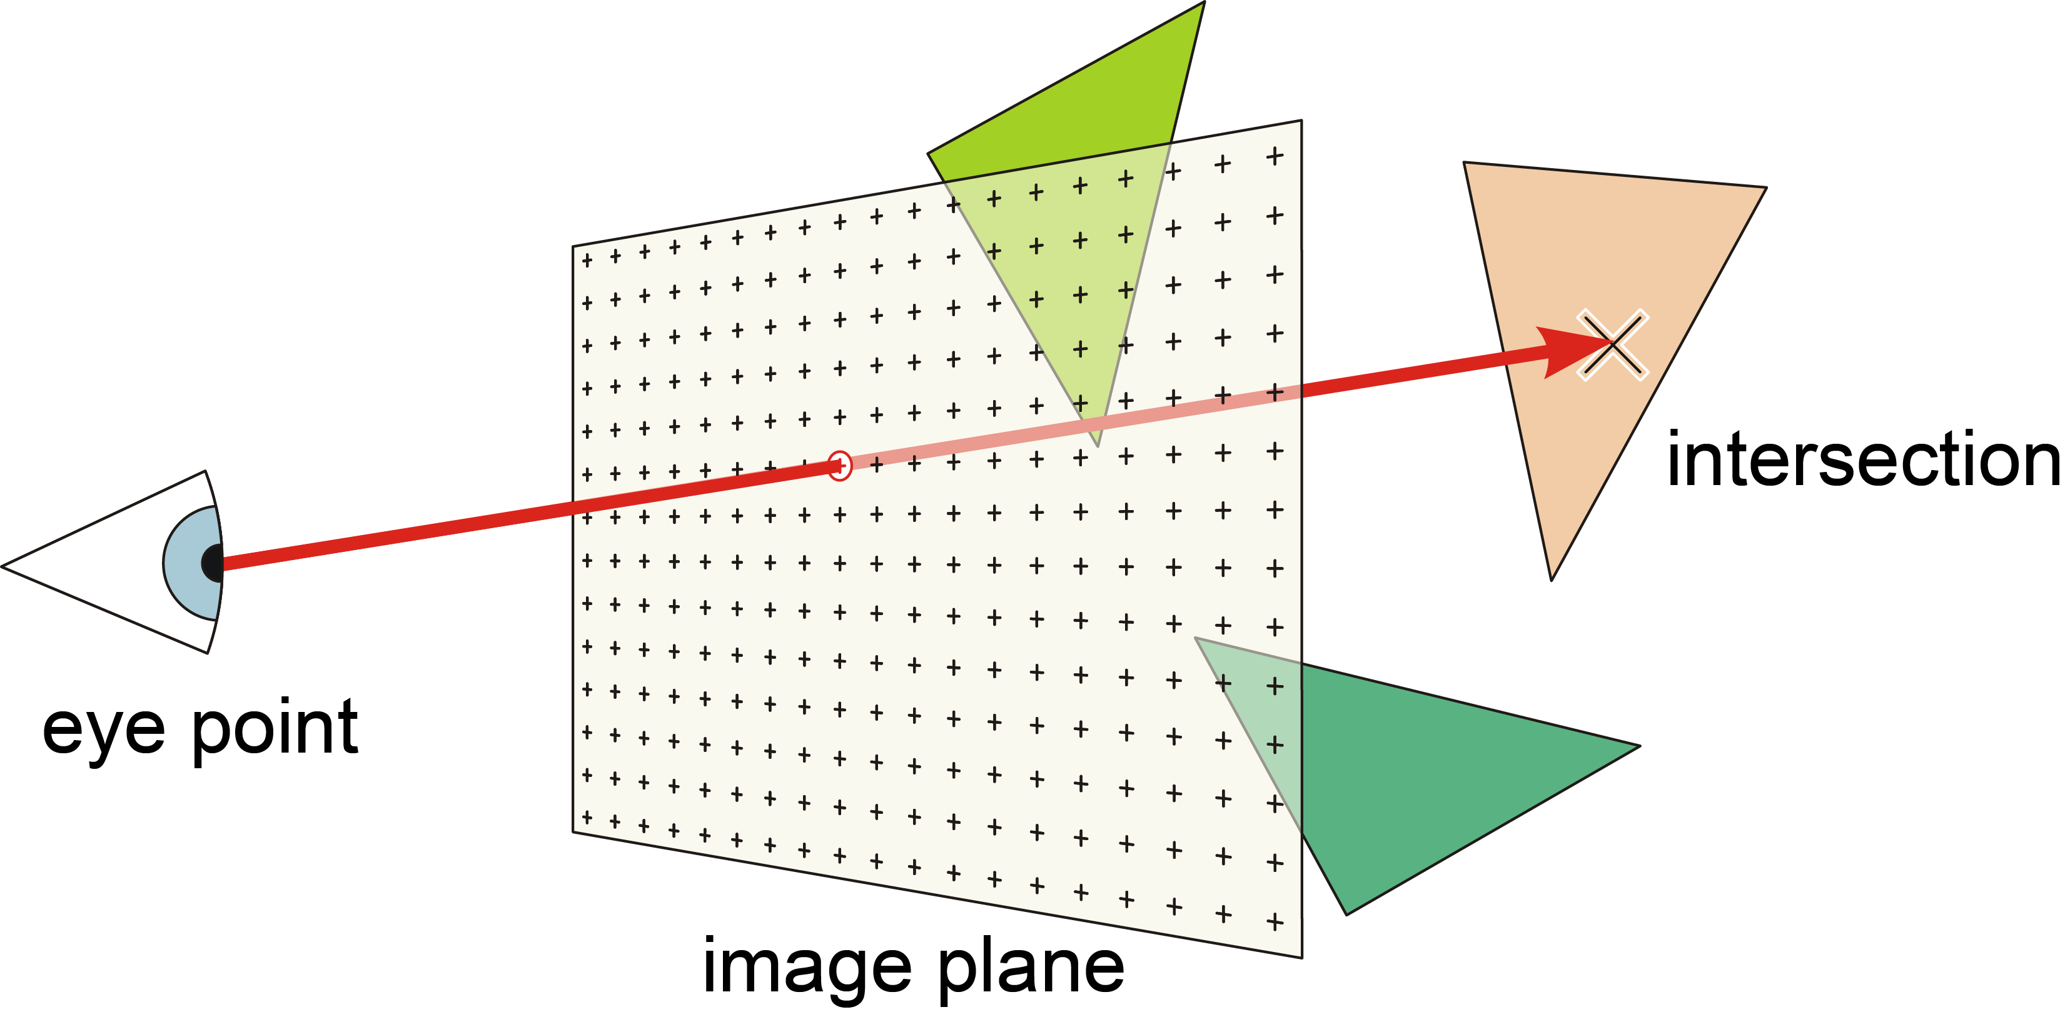
Ray casting

Slide 10
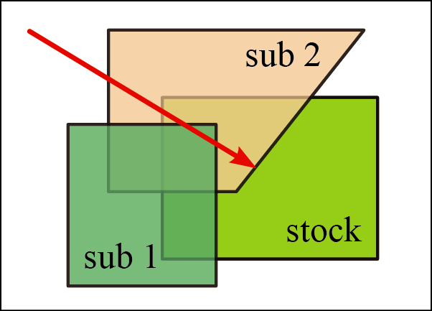
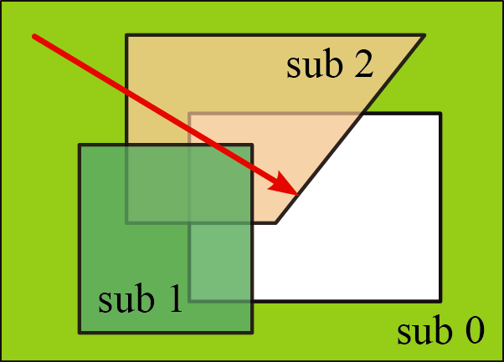

Swept volumes - entry/exit counting

Slide 11
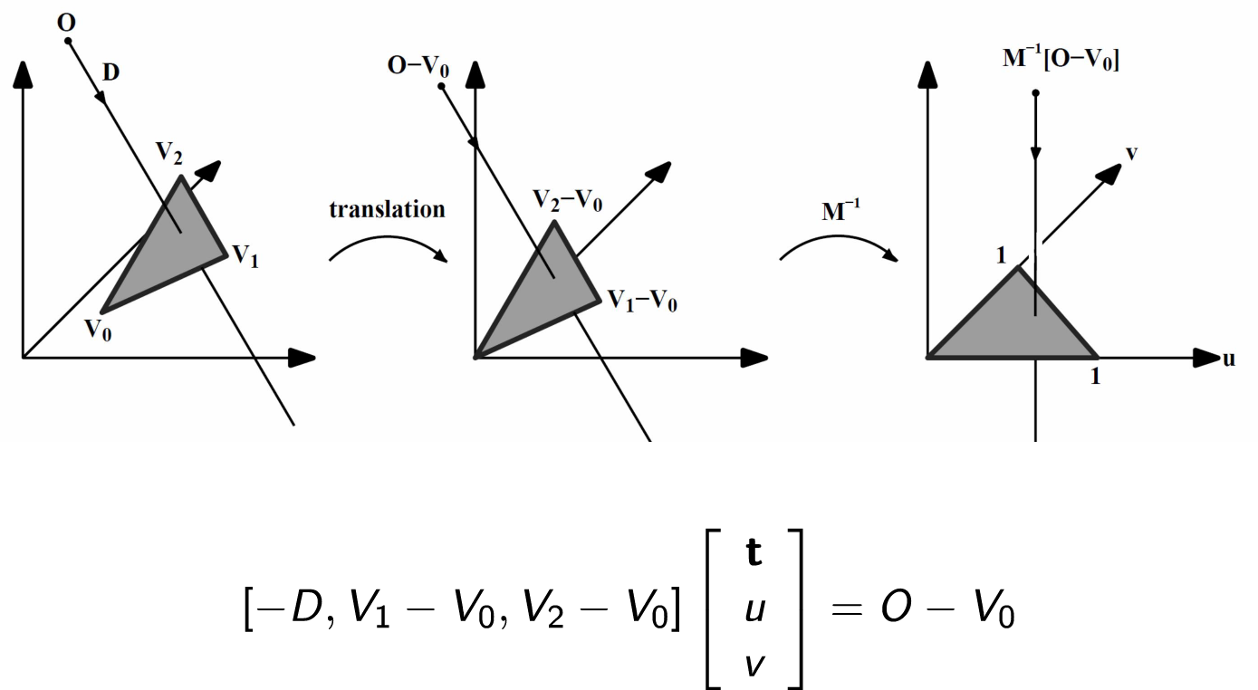
Triangle ray intersection
Fast, Minimum Storage Ray/Triangle Intersection, Möller & Trumbore, 1997
Image: Torsten Welsch

Slide 12
Result
Position
Normal vector of hit triangle
Per ray/pixel
Use shading to get a color value

Slide 13
OpenGL integration - Composition

Slide 14
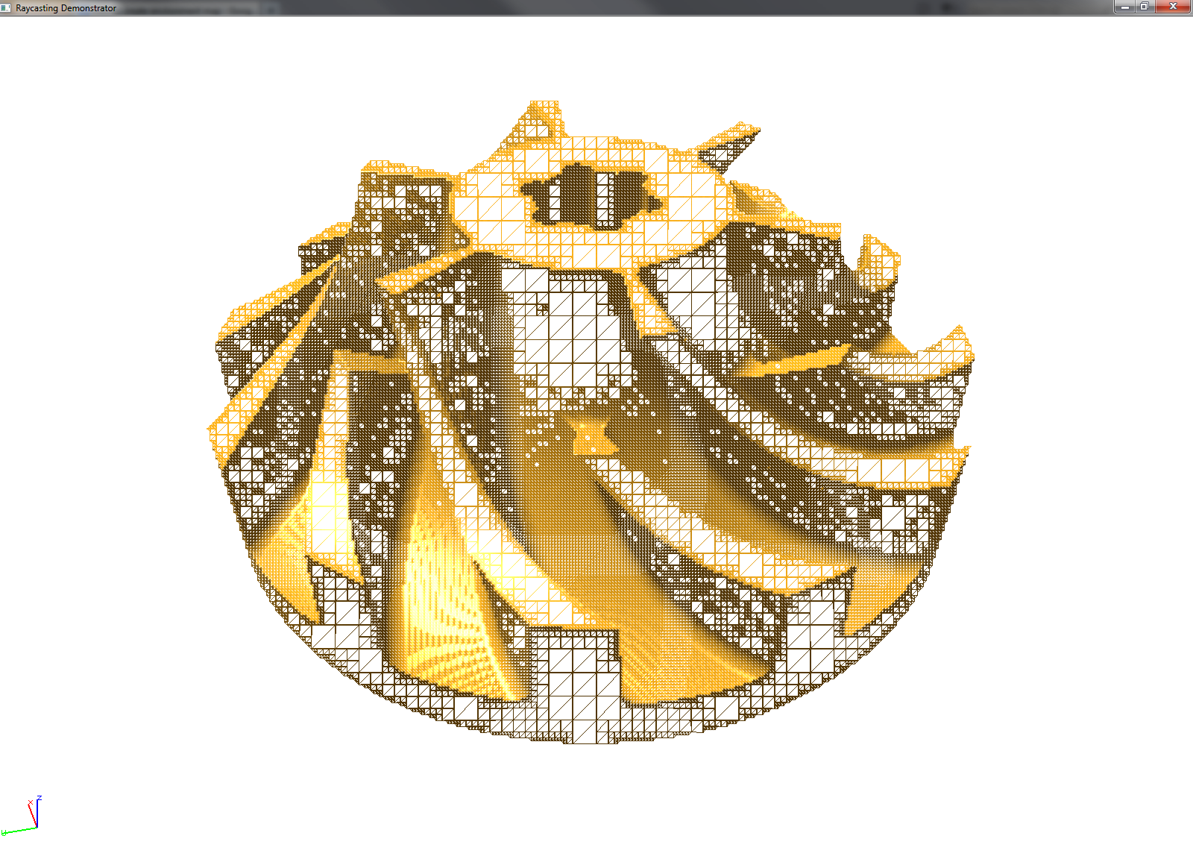
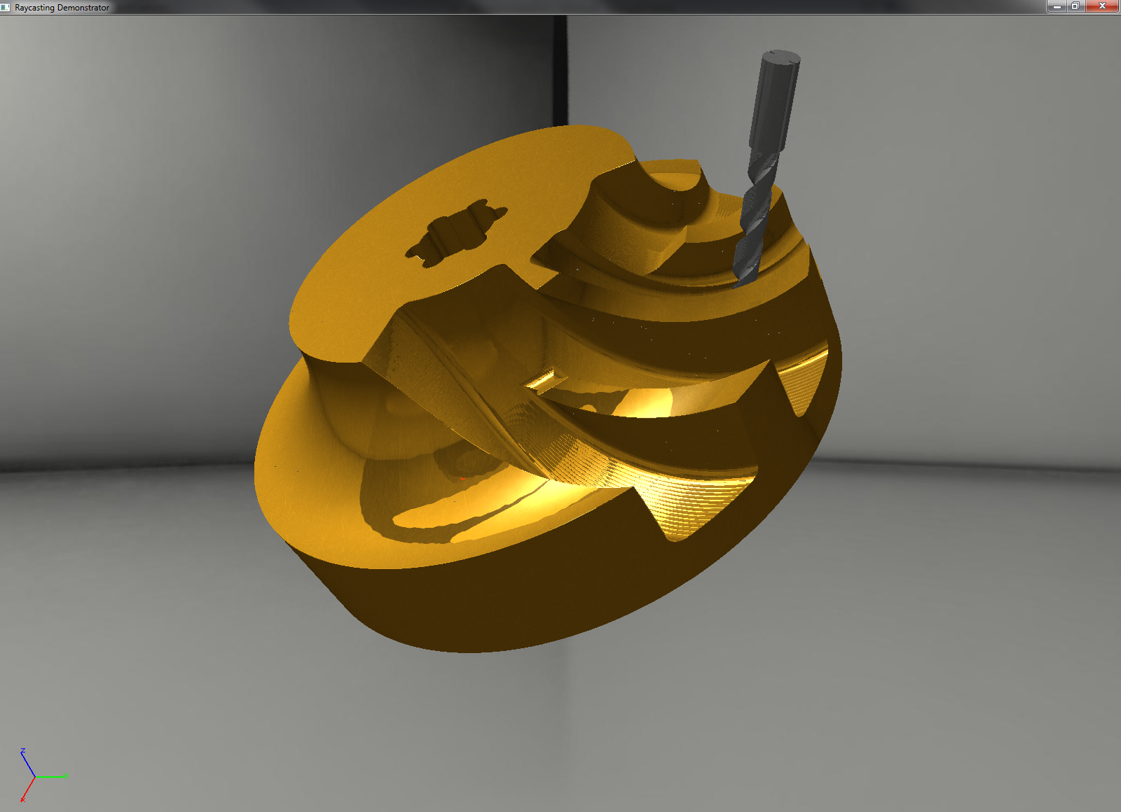
OpenGL integration - Retriangulation

Slide 15
Acceleration
Trees
Grids

Slide 16
Regular grid

Slide 17
Traversal

Slide 18
Optimizing triangle count

Slide 19
Cell classification

Slide 20
Open volumes

Slide 21
Triangle reduction

Slide 22
Vectorization and memory locality

Slide 23
Packet casting

Slide 24
GPU Acceleration

Slide 25
Runtime benchmark

Slide 26
Visual quality

Slide 27
Master thesis

